Slide 1

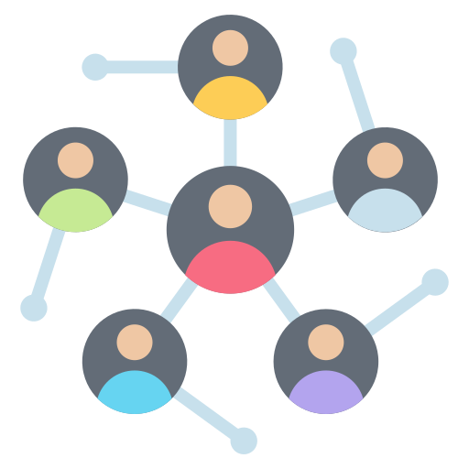
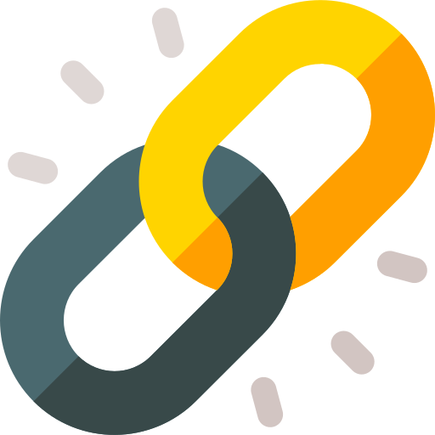

ProConnect
Social media platform designed to facilitate genuine connections
Company name : QSpider’s Panjagutta
Industry Guide : Shiak Reshma
Designation : WebTechnology Trainer
Faculty Supervisor: Dr.Arun Vaishnav
Assistant Prof

Slide 2
Project Description
ProConnect [Professional Connect] is a modern social media web application with a clean, minimalistic interface. It's built to encourage genuine, meaningful connections without the noise and superficiality often seen on traditional platforms.
The platform emphasizes authentic interactions, aiming to connect friends without exaggeration. It offers features like stories, ensuring users can share moments without embellishments. The homepage encourages visitors to "Join Now," indicating an invitation for new users to become part of this community.
Key Features:
Real-time stories: Users can share updates that reflect real life, avoiding over-edited or exaggerated content.
Simplified user experience: The UI is intuitive and straightforward, reducing distractions and encouraging engagement.
Profile creation & management: Each user can create their personalized profile and connect with others.

Slide 3

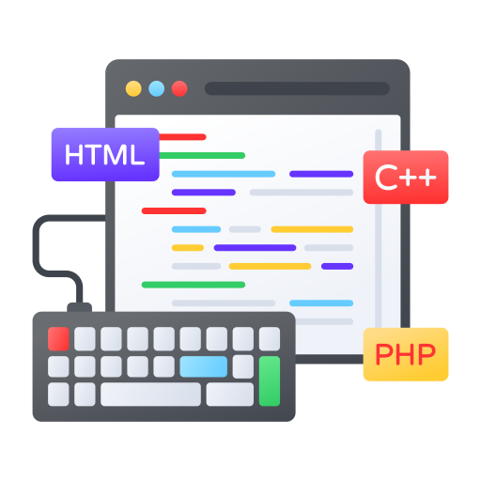
Work completed
So far, 98% of the development is complete, and the project has been in progress for nearly 3.5 months. The core features such as user authentication, profile creation, real-time story sharing, and a clean, responsive UI have already been implemented successfully.
Completed Features:
User signup/login system
Profile management
Story/post sharing functionality
Clean and intuitive frontend design (likely using React and pure CSS)
Hosting & deployment

Slide 4
Future Work
Integrating notifications for likes, comments, and connection requests.
Implementing real-time updates using technologies like WebSockets or Firebase.
Strengthening user authentication and session management with improved token handling.
Adding privacy settings and user controls (block/report/mute options).
Finalizing error handling across frontend and backend.

Slide 5


Key Learning and Skills Developed
Gained a deep understanding of full-stack web development, from UI design to backend integration.
Learned how to build user-centric features with an emphasis on clean design and usability.
Developed insights into building real-time functionalities using technologies like WebSockets.
Experienced the full software development lifecycle, including planning, development, testing, and deployment.
Skills Developed
Frontend Development
Backend & Integration
Basic to intermediate skills in Node.js / Express
Soft Skills
Time management

Slide 6
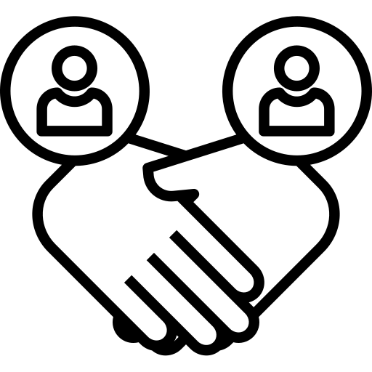
Conclusion
Working on the ProConnect project has been a valuable hands-on experience in full-stack development. It allowed me to apply my technical knowledge, explore real-time features, and build a user-focused application from the ground up. I’m confident that the remaining tasks will further enhance both the functionality and user experience, making ProConnect a meaningful and authentic social platform.

Slide 7
.
Work, work, work—let this be your motto
Thank You….

